Slide 1
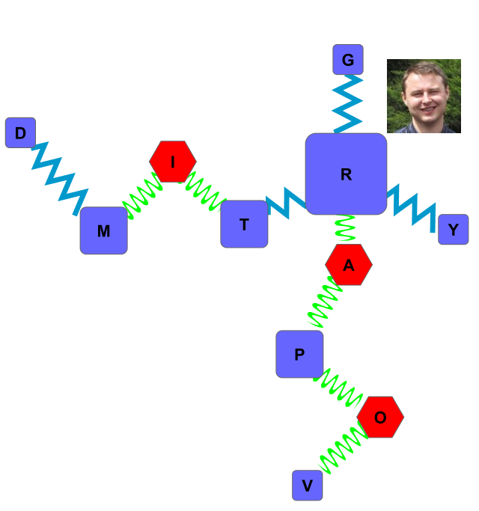
Introduction to network mapping
Goal: Generate a mapped “name” network
Topics:
Edge list
Node attributes
Network Mapping
Cytoscape

Slide 2
Network Mapping
Steps:
Make Edge list
Make Node attributes
Generate Network
Map node attributes
Final touches
See Items in “Network” folder for results

Slide 3

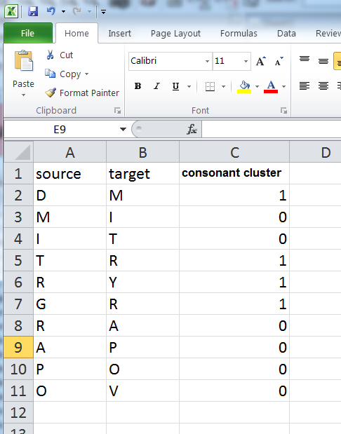
Edge List
Minimum Requirements:
2 column matrix with source (start) and target (end) nodes (e.g. letters)
extra columns can be used to set edge (connection) aesthetics (e.g. width, color, etc.)
See file “name edge list.xlsx” for an example edge list defining how the letters in my name (Dmitry Grapov) are connected with an extra column identifying consonants

Slide 4
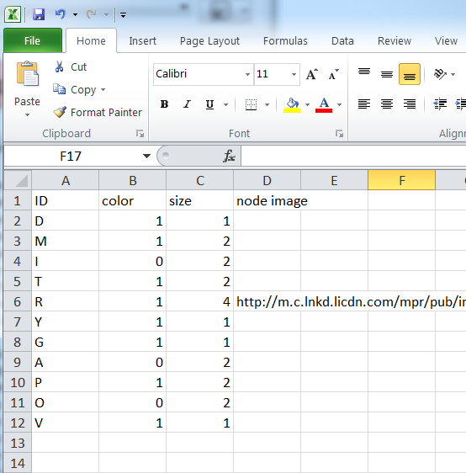
Node Attributes
Minimum Requirements:
ID for nodes (rows) must match the edge ID
Extra columns can be used to set each nodes properties (e.g. color, size, image, etc.)
See file “node attributes.xlsx” for an example node attributes file

Slide 5
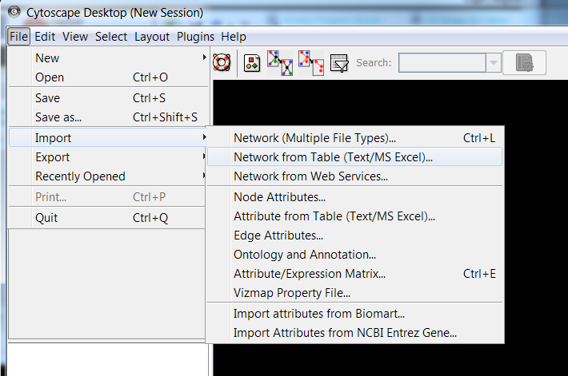
Network Generation
Use Cytoscape to generate network (v2.83)
(http://www.cytoscape.org/ )
Import Edge list (this can be many forms)
1
2

Slide 6
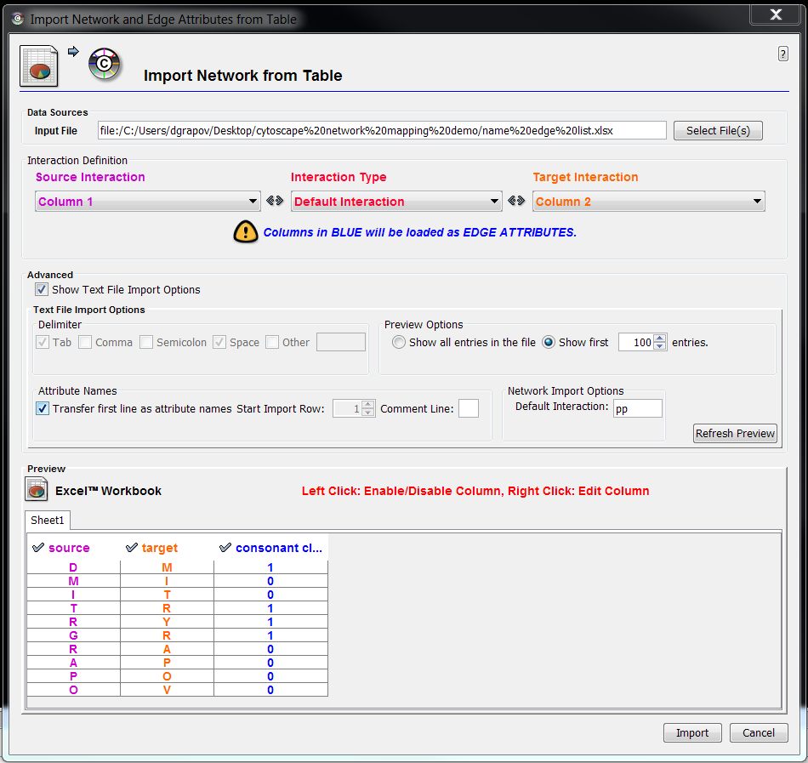
Network Generation (cont.)
1. Select file for edge list
2. Identify columns for edge (connection) source and target.
Double click column to enable edge attributes.
Hint: Show Text File Import Options>>Transfer first line…..
1
2
3
4
5
6

Slide 7
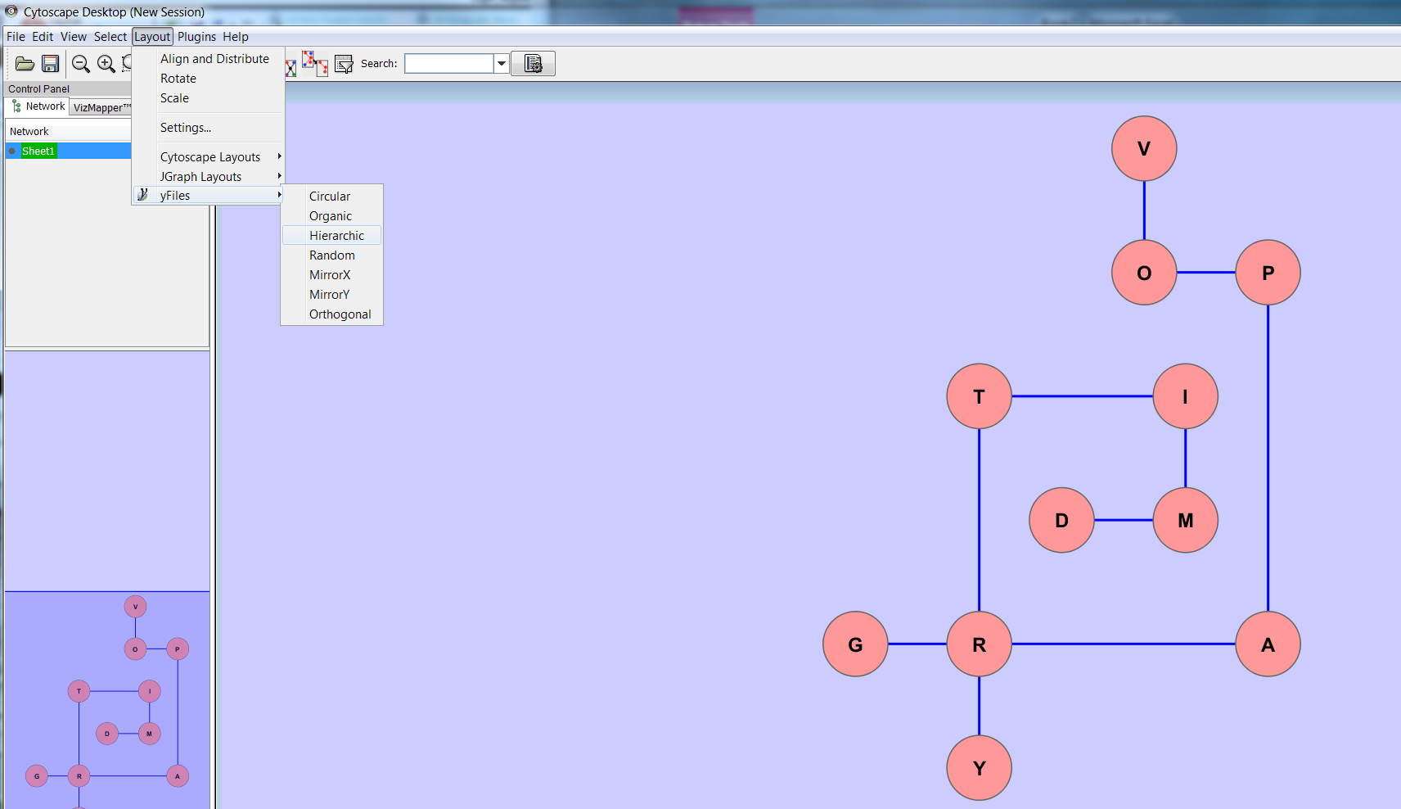
Node Layout
Cytoscape provides many options to help auto-optimize the node (letters) layout
1
2 (3 default add-ins)
3

Slide 8
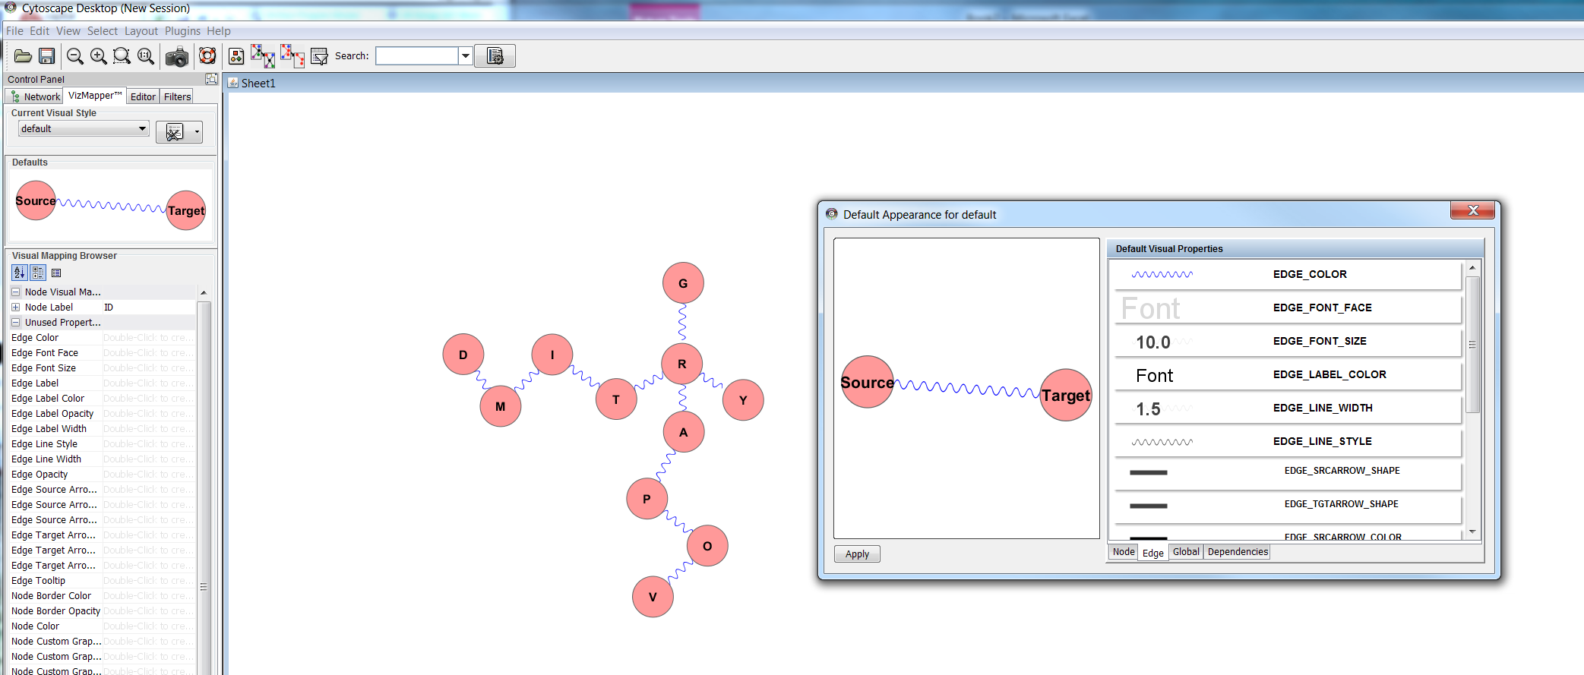
Global Defaults
Set defaults to modify global node, edge and other options.
Double-click on Defaults image
1
3
2

Slide 9
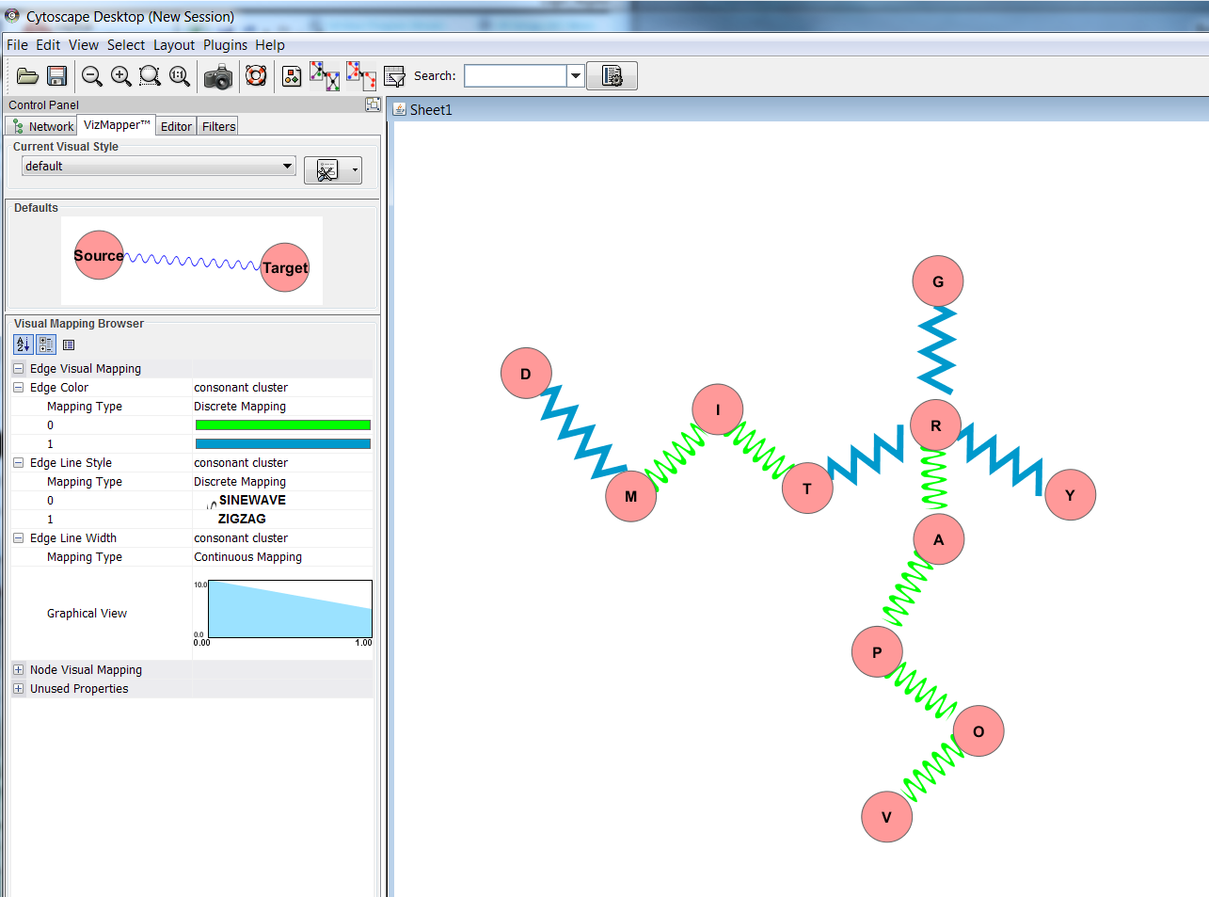
Modify Edge Attributes
Use the VizMapper to map “extra columns” in edge list (attributes) to aesthetics.
1

Slide 10
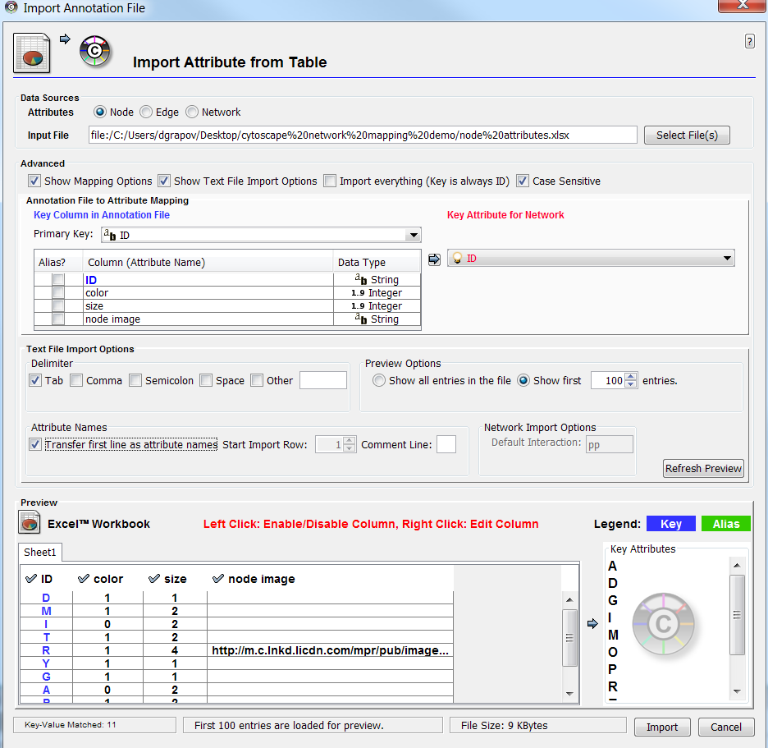
Node Attributes
Select file for the node attributes. Extra options can be used to select node ID (must match edge list), change the file delimiter, etc.
1
3
2
4
5
6

Slide 11
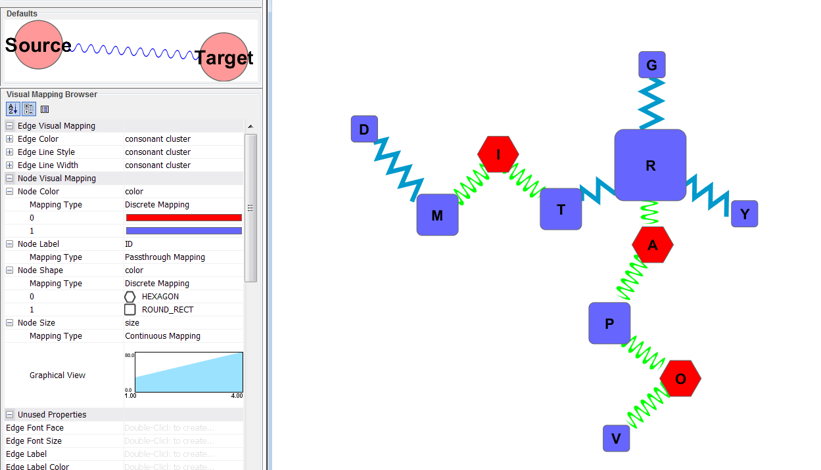
Modify Node Attributes
Use the VizMapper to map node attributes.
1

Slide 12
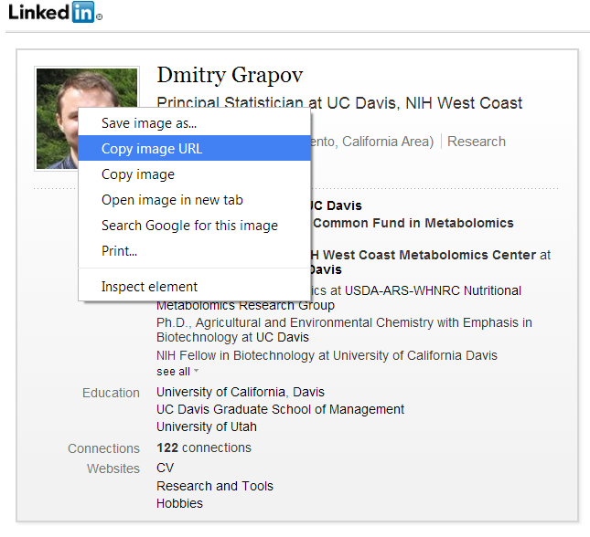
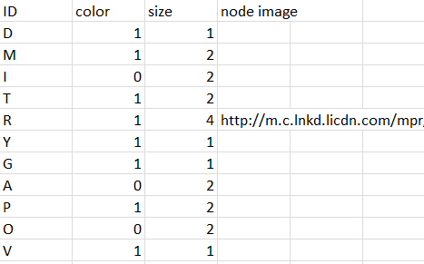
Add node images
New columns can be added to the node attributes and change the mapping in existing networks. Here I’ll add a url for a .png to use as a custom node image. Custom images can also be defined as local file path (e.g. windows: file:///C:\.....)

Slide 13
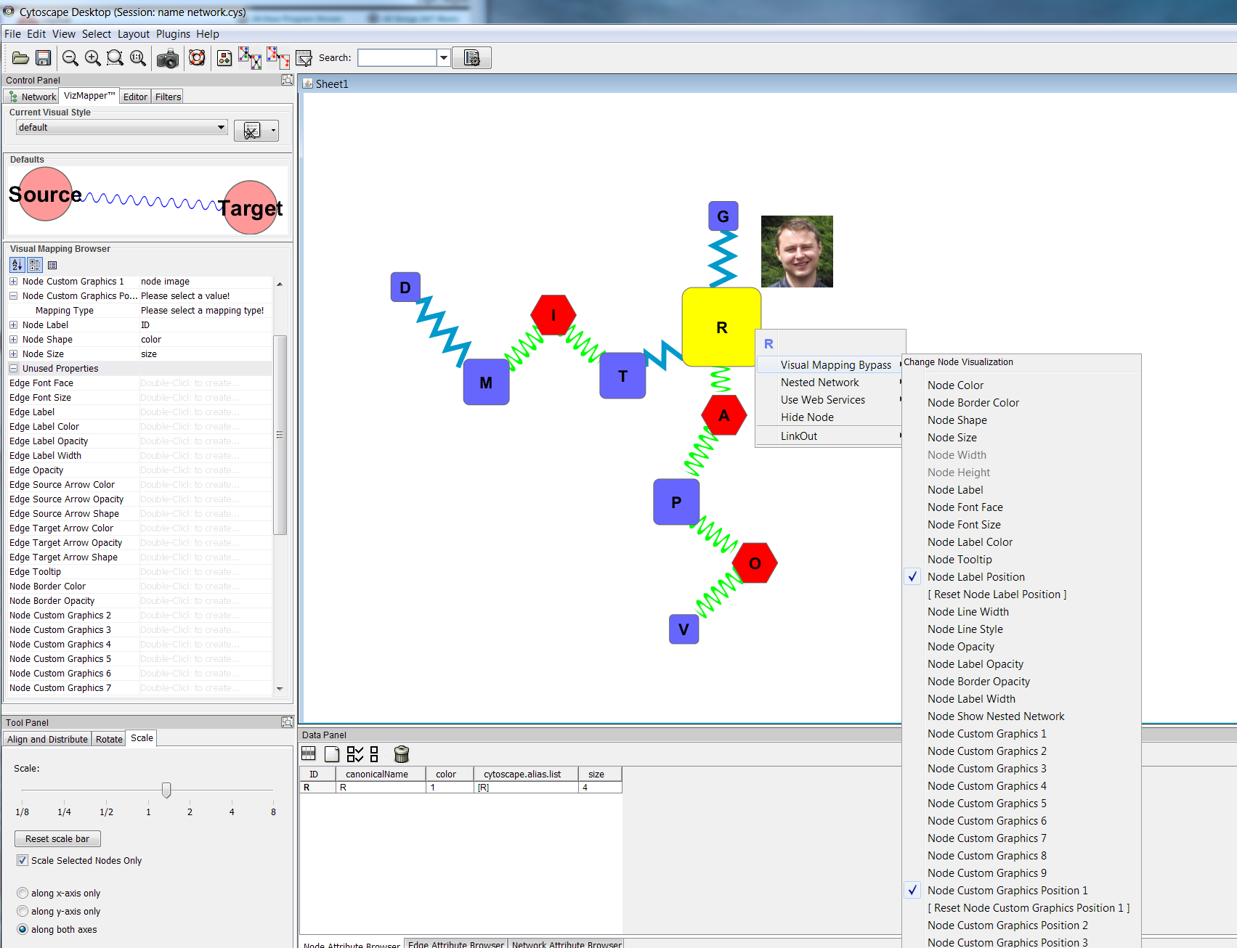
Override mapped attributes
Right-click on an edge or node to manually change their aesthetics
1
2
3

Slide 14
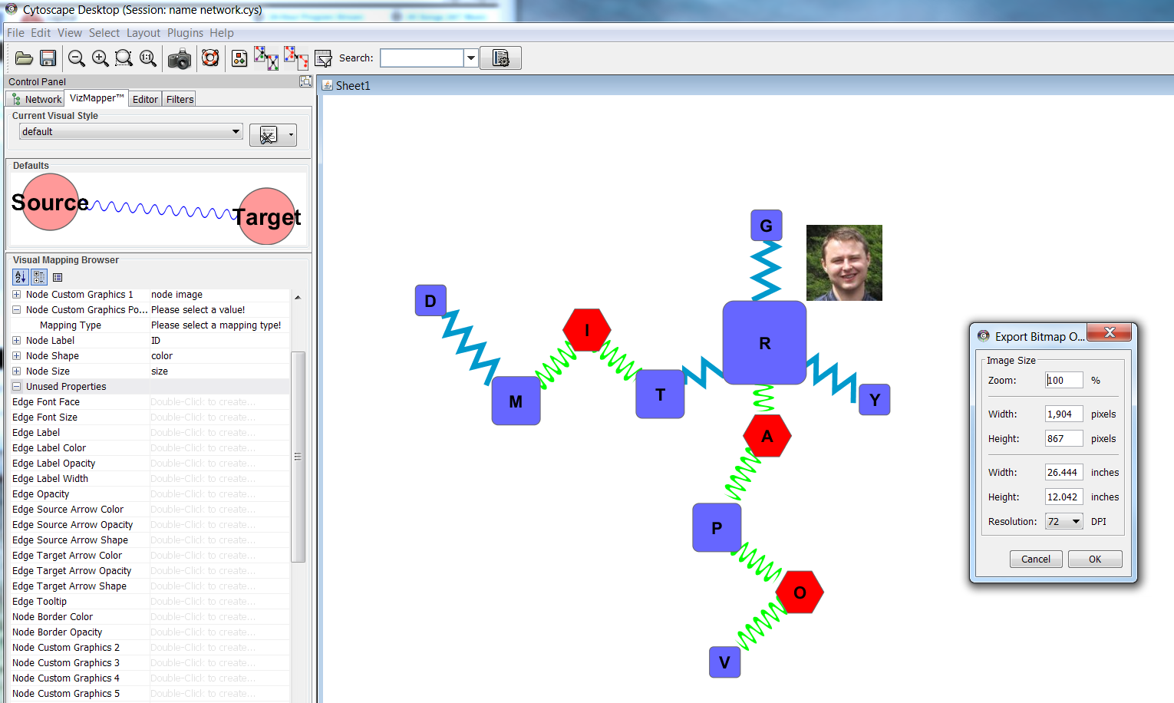
Export Network as Image
Export as .pdf or .svg to further modify (and beautify) the network.
1
2

Slide 15
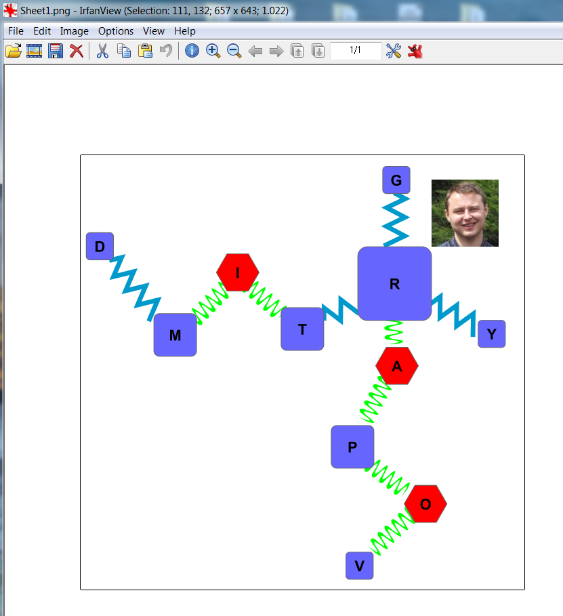
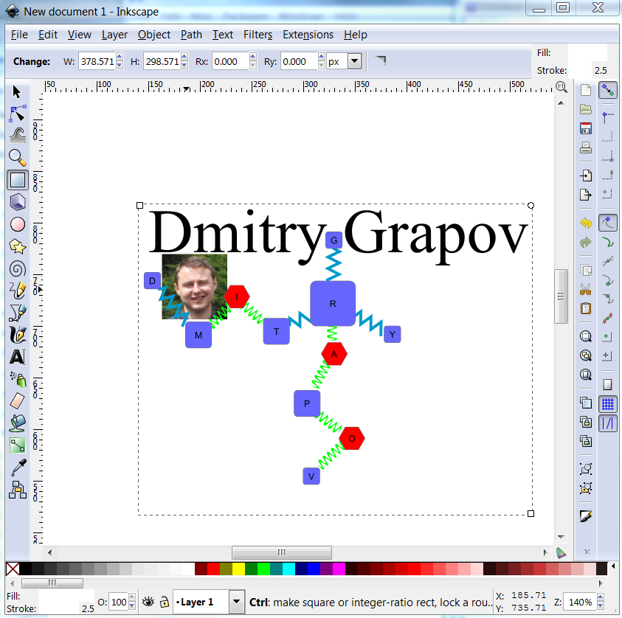
Final Touches
Use irfanview (http://www.irfanview.com/) for minor edits or inkscape (http://www.inkscape.org/en/) for complete control of final touches including making legends.

